Slide 1
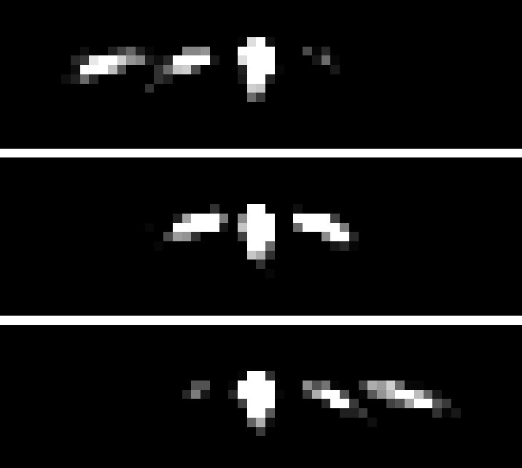

ANALYSIS OF NEUTRON DIFFRACTION BY OPTICALLY THIN GRATING
Student:
Ismaele Vincent Masiello
Supervisors:
Simon E. Wall¹
Jürgen Klepp²
¹Department of Physics and Astronomy, University of Aarhus, Ny Munkegade, Building 1520, DK-8000 Aarhus C, Denmark
²University of Vienna, Faculty of physics, Boltzmanngasse 5, 1090 Vienna, Austria

Slide 2
INTRODUCTION

Slide 3
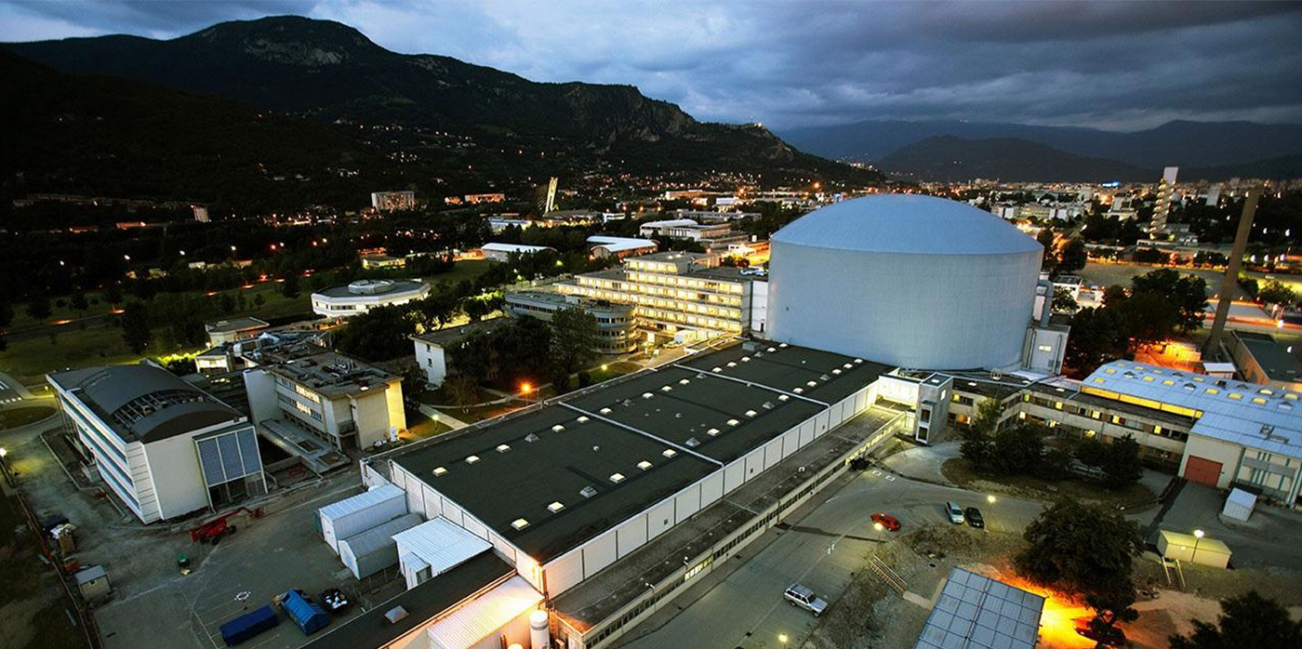
TOPIC
Analysis of a neutron diffraction by holographic grating, performed at the Institute Laue-Langevin (Grenoble, France, 2012/2013)

Slide 4
WHY HOLOGRAPHIC GRATINGS
Versatile optical component for neutron- and laser- optics¹
Jürgen Klepp et al. “Advancing data analysis for reflectivity measurements of holographic nanocomposite gratings”. In: Journal of Physics: Conference Series 746 (Sept. 2016), p. 012022.

Slide 5
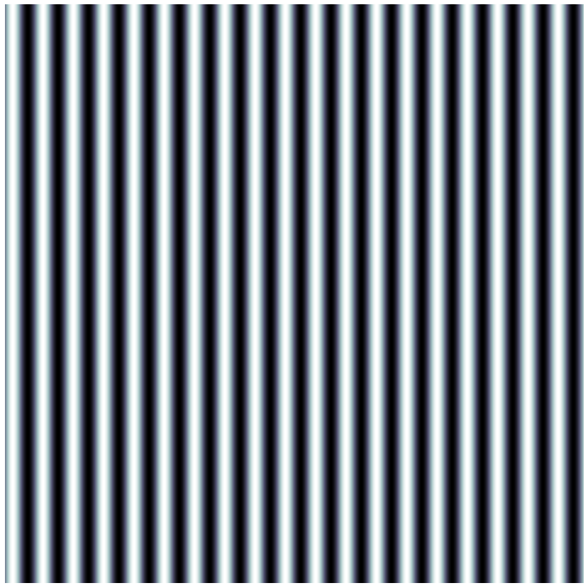
OPTICALLY THICK/THIN GRATINGS
. . .
-2
-2
-1
-1
Incoming
Incoming
beam
0
beam
0
1
. . .
T. K. Gaylord and M. G. Moharam. “Thin and thick gratings: terminology clarification”. In: Appl. Opt. 20.19 (Oct. 1981), pp. 3271–3273.

Slide 6
DIFFRACTION EXPERIMENT
-2
-1
Incoming
beam
0
1
θ

Slide 7
THE DATA

Slide 8
THEORY
FIRST-ORDER MULTI-WAVE MODEL

Slide 9
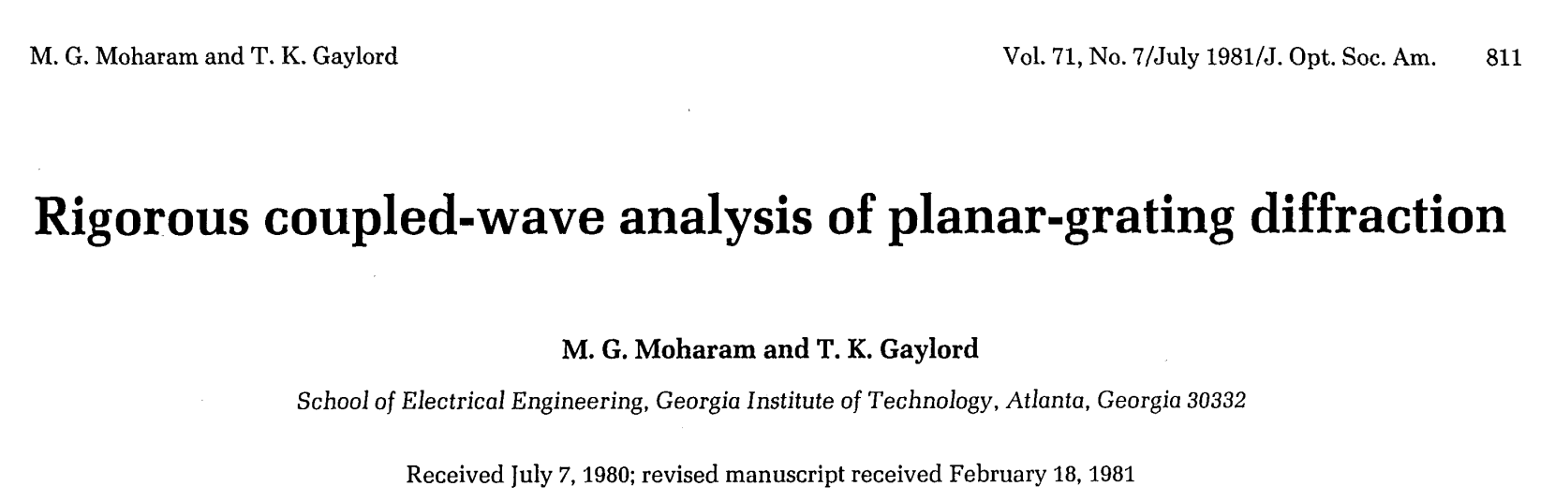
RCWA
What follows is a re-adaptation and approximation of the Rigorous Coupled-Wave Analysis (RCWA) presented by M. G. Moharam and T. K. Gaylord.
M. G. Moharam and T. K. Gaylord. “Rigorous coupled-wave analysis of planar-grating diffraction”. In: J. Opt. Soc. Am. 71.7 (July 1981), pp. 811–818.

Slide 10
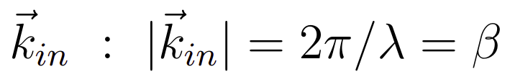
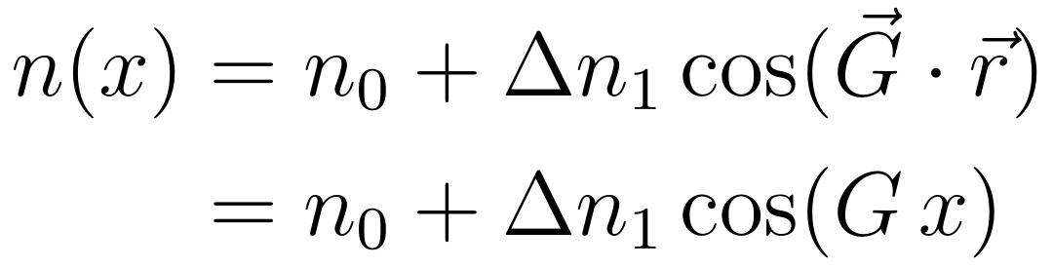
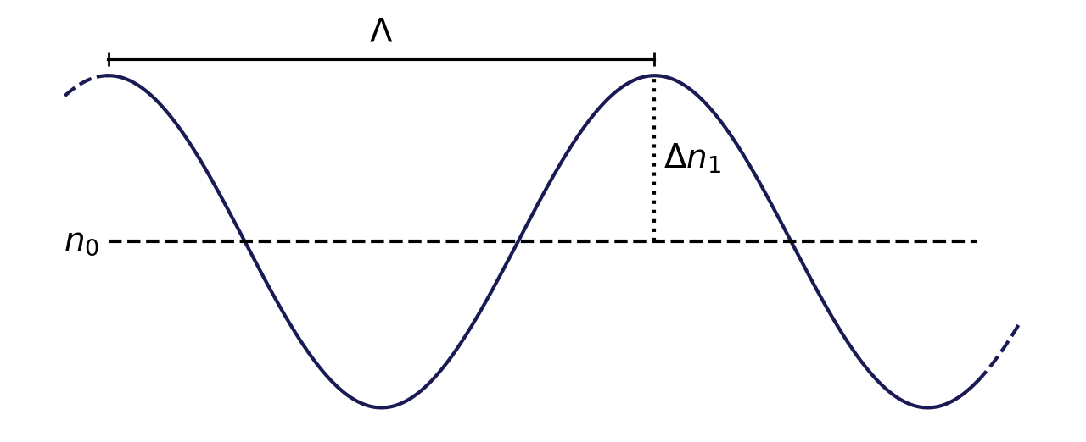
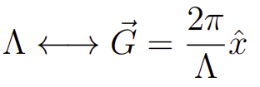
HOLOGRAPHIC GRATING
d
REFRACTIVE INDEX PROFILE
Incoming
beam
z
x

Slide 11
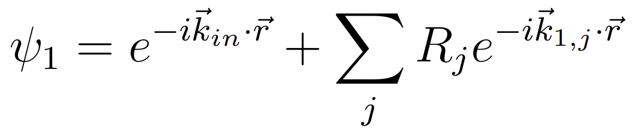
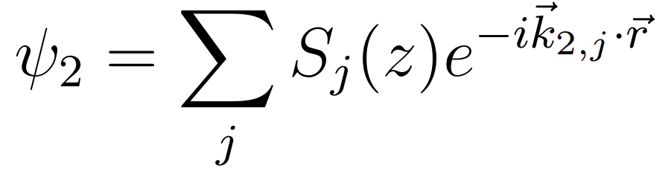
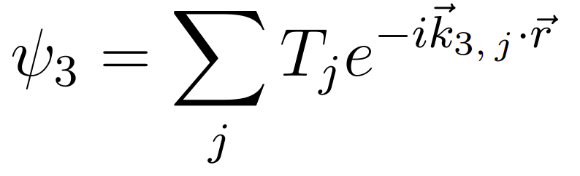
REFRACTIVE INDEX PROFILE
Region
1
Region
2
Region
3
Forward
diffracted
waves
REFRACTIVE INDEX PROFILE
REGION 1
. . .
. . .
-2
-2
-1
-1
REGION 2
0
0
z
+1
+1
. . .
. . .
Backward
diffracted
waves
REGION 3
x

Slide 12
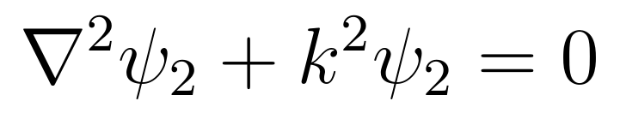
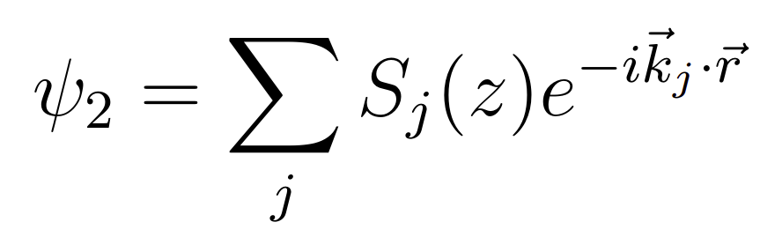
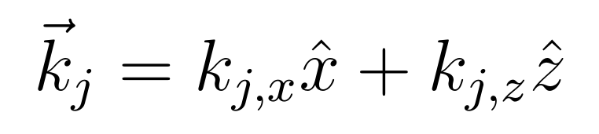
REGION 2
TIME INDEPENDENT WAVE EQUATION

Slide 13
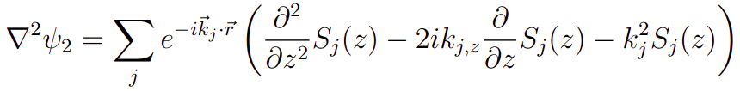
REGION 2
TIME INDEPENDENT WAVE EQUATION

Slide 14
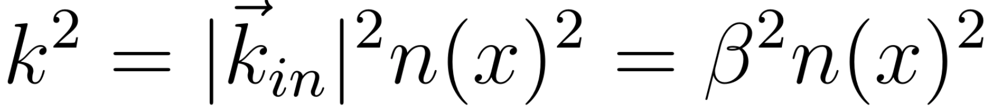
REGION 2
TIME INDEPENDENT WAVE EQUATION
REFRACTIVE INDEX PROFILE

Slide 15

REGION 2
TIME INDEPENDENT WAVE EQUATION
Martin Fally, J ̈urgen Klepp, and Yasuo Tomita. “An experimental study on the validity of diffraction theories for off-Bragg replay of volume holographic gratings”. In: Applied Physics B 108 (July 2012).

Slide 16
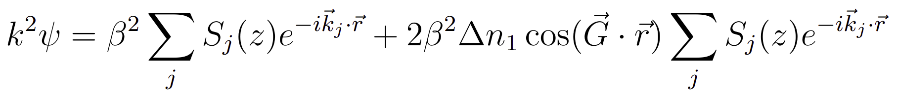
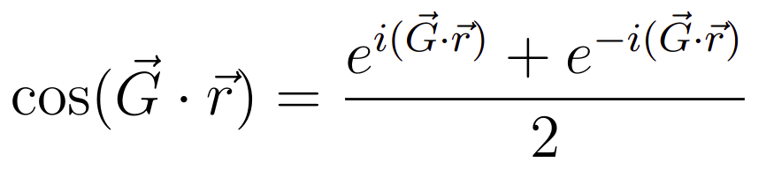
REGION 2
TIME INDEPENDENT WAVE EQUATION

Slide 17
REGION 2
TIME INDEPENDENT WAVE EQUATION

Slide 18

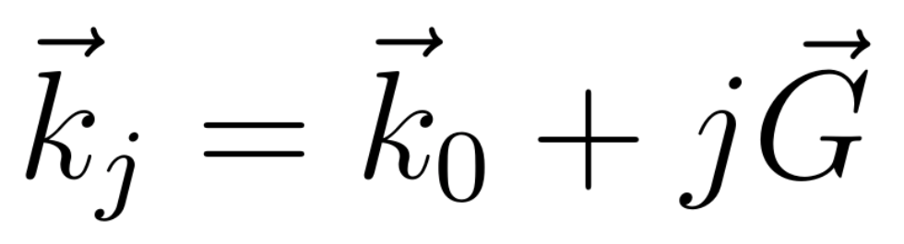
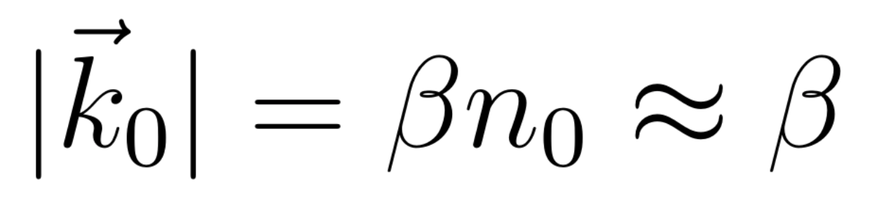
Region
1
Region
2
FLOQUET’S CONDITION
K-VECTOR CLOSURE METHOD (KVCM)
z
x
Martin Fally, J ̈urgen Klepp, and Yasuo Tomita. “An experimental study on the validity of diffraction theories for off-Bragg replay of volume holographic gratings”. In: Applied Physics B 108 (July 2012).
Matej Prijatelj et al. “Far-off-Bragg reconstruction of volume holographic gratings: A comparison of experiment and theories”. In: Physical Review A 87.6 (June 2013).

Slide 19
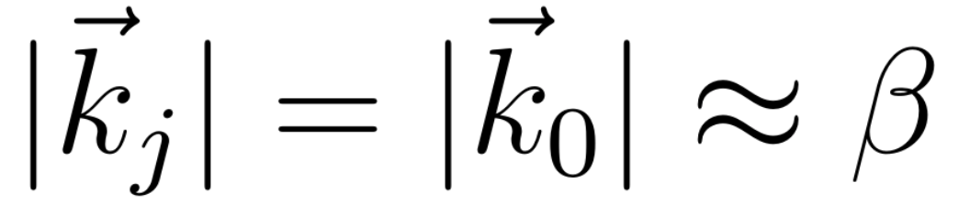
Region
1
Region
2
FLOQUET’S CONDITION
FLOQUET’S CONDITION
FLOQUET’S CONDITION
K-VECTOR CLOSURE METHOD (KVCM)
z
BETA VALUE METHOD (BVM)
x
Martin Fally, J ̈urgen Klepp, and Yasuo Tomita. “An experimental study on the validity of diffraction theories for off-Bragg replay of volume holographic gratings”. In: Applied Physics B 108 (July 2012).
Matej Prijatelj et al. “Far-off-Bragg reconstruction of volume holographic gratings: A comparison of experiment and theories”. In: Physical Review A 87.6 (June 2013).

Slide 20
Region
1
Region
2
FLOQUET’S CONDITION
. . .
K-VECTOR CLOSURE METHOD (KVCM)
z
. . .
BETA VALUE METHOD (BVM)
x
Martin Fally, J ̈urgen Klepp, and Yasuo Tomita. “An experimental study on the validity of diffraction theories for off-Bragg replay of volume holographic gratings”. In: Applied Physics B 108 (July 2012).
Matej Prijatelj et al. “Far-off-Bragg reconstruction of volume holographic gratings: A comparison of experiment and theories”. In: Physical Review A 87.6 (June 2013).

Slide 21
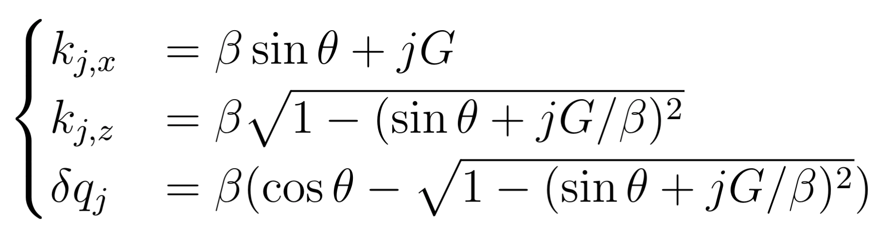
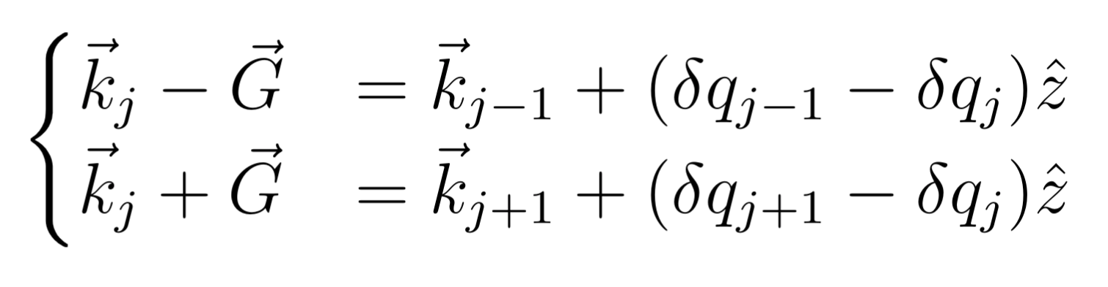
Region
1
Region
2
. . .
z
. . .
x

Slide 22
REGION 2
TIME INDEPENDENT WAVE EQUATION

Slide 23
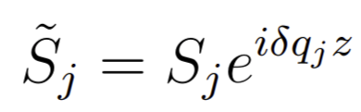
REGION 2
TIME INDEPENDENT WAVE EQUATION
FIRST ORDER APPROXIMATION OF RCWA

Slide 24
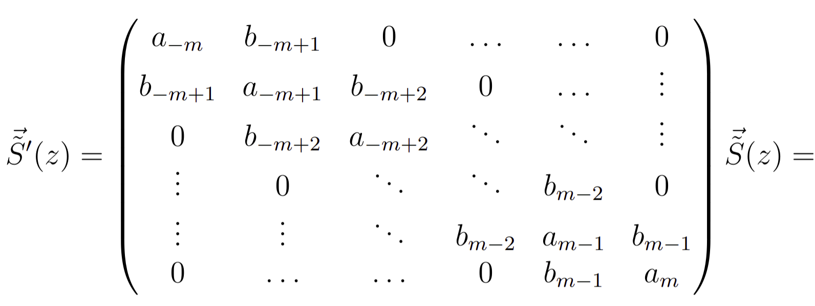
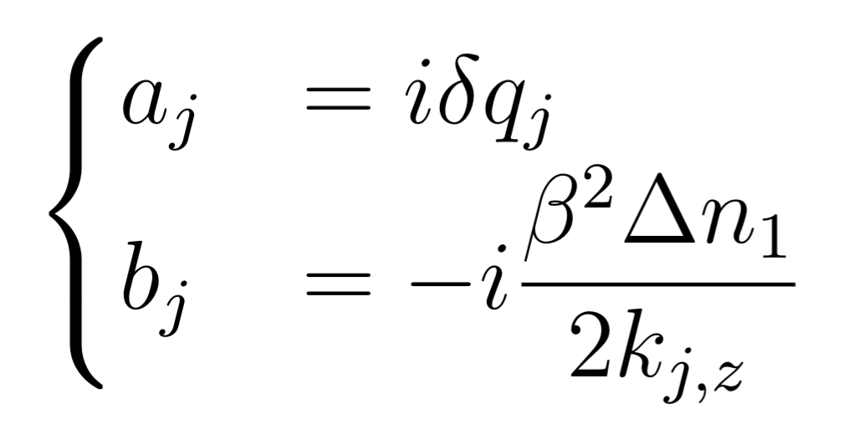
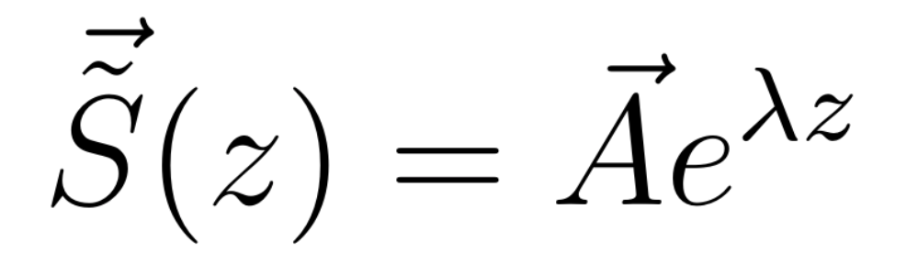
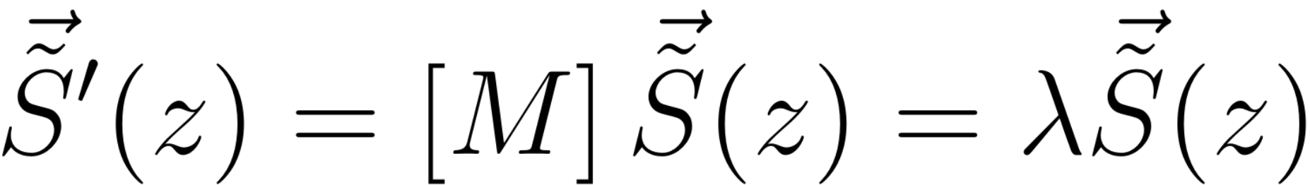
REGION 2
FIRST ORDER APPROXIMATION OF RCWA
Ansatz
Eigenvalue solution

Slide 25
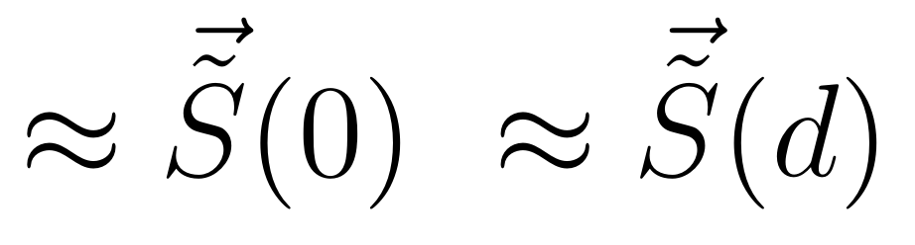
Region
1
Region
2
Region
3
Forward
diffracted
waves
. . .
. . .
-2
-2
-1
-1
0
0
z
+1
+1
. . .
. . .
Backward
diffracted
waves
x

Slide 26
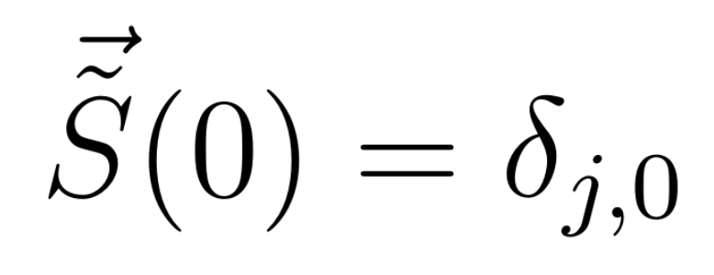
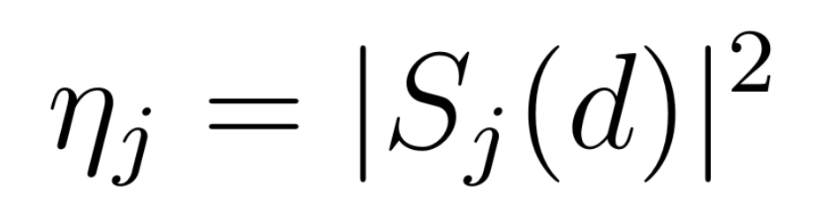
DIFFRACTION EFFICIENCIES
INITIAL CONDITIONS
J-TH ORDER DIFFRACTION EFFICIENCY

Slide 27
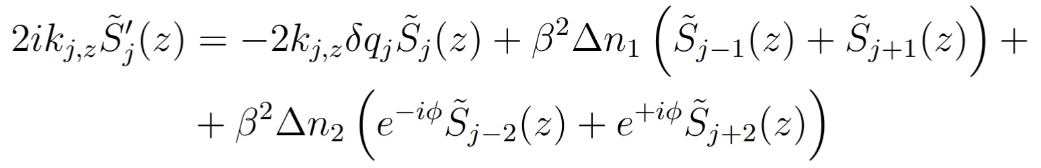
HIGHER FOURIER COMPONENTS
TWO FOURIER COMPONENTS OF THE REFRACTIVE INDEX MODULATION
FIRST ORDER WAVE EQUATION

Slide 28
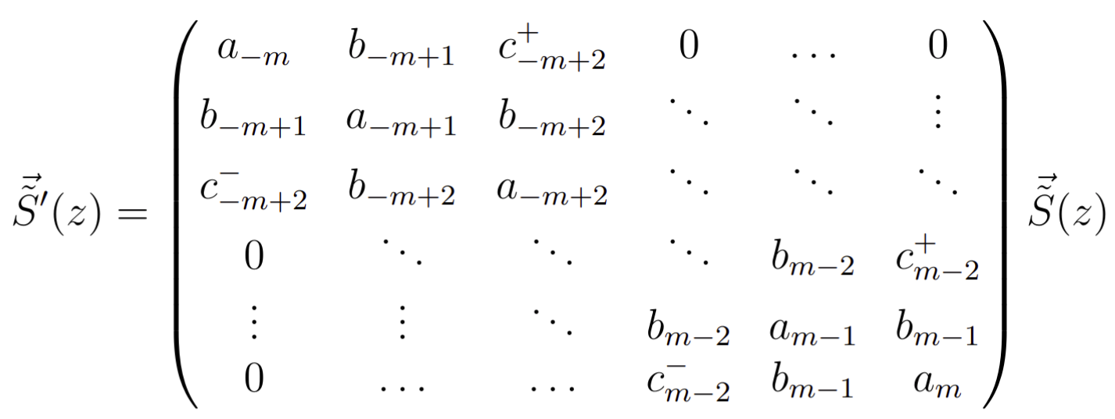
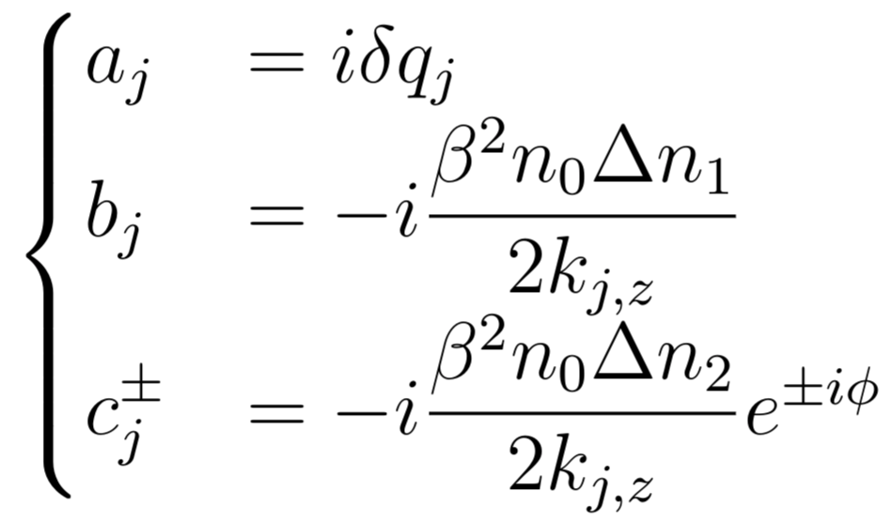
HIGHER FOURIER COMPONENTS

Slide 29
THEORY
PENDELLÖSUNG INTERFERENCE

Slide 30
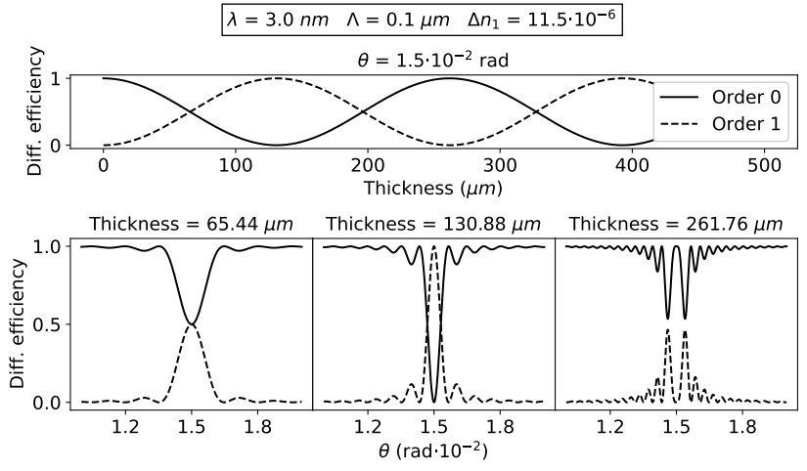
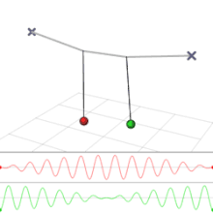
PENDELLÖSUNG INTERFERENCE
Pendellösung: (English) Pendulum solution
FIXED:
Wavelength
Incident angle
Modulation profile

Slide 31
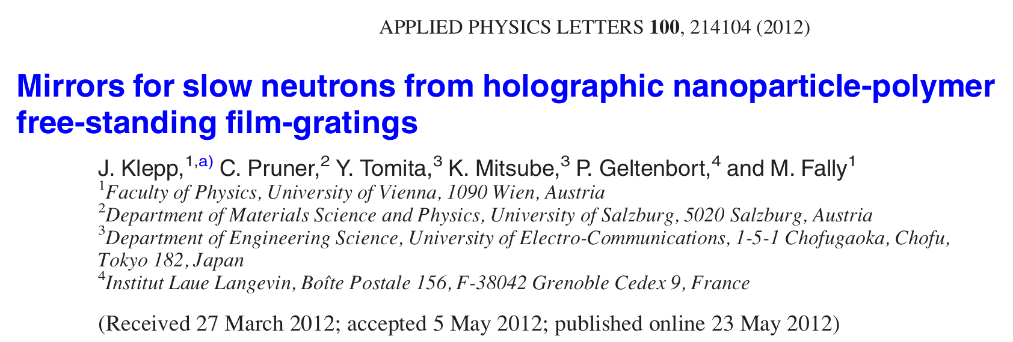
PENDELLÖSUNG INTERFERENCE
Christian Pruner et al. “Interferometer for cold neutrons”. In: Nuclear Instruments and Methods in Physics Research Section A: Accelerators, Spectrometers, Detectors and Associated Equipment 560.2 (2006), pp. 598–605. issn: 0168-9002

Slide 32
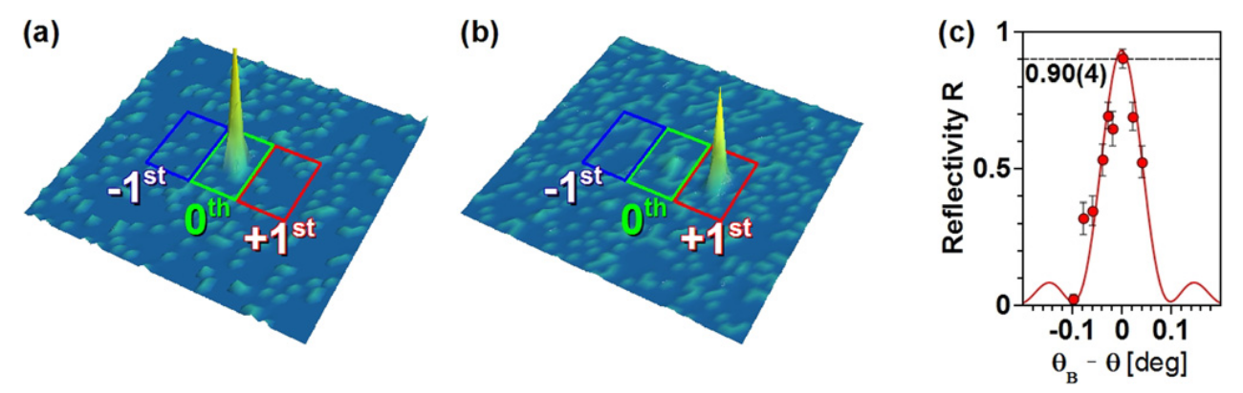
PENDELLÖSUNG INTERFERENCE
Christian Pruner et al. “Interferometer for cold neutrons”. In: Nuclear Instruments and Methods in Physics Research Section A: Accelerators, Spectrometers, Detectors and Associated Equipment 560.2 (2006), pp. 598–605. issn: 0168-9002

Slide 33
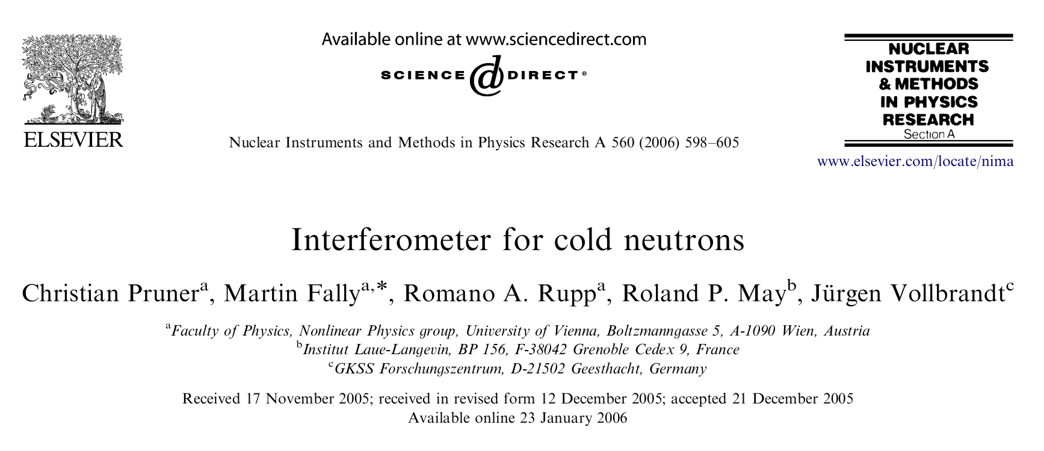
PENDELLÖSUNG INTERFERENCE
Christian Pruner et al. “Interferometer for cold neutrons”. In: Nuclear Instruments and Methods in Physics Research Section A: Accelerators, Spectrometers, Detectors and Associated Equipment 560.2 (2006), pp. 598–605. issn: 0168-9002

Slide 34
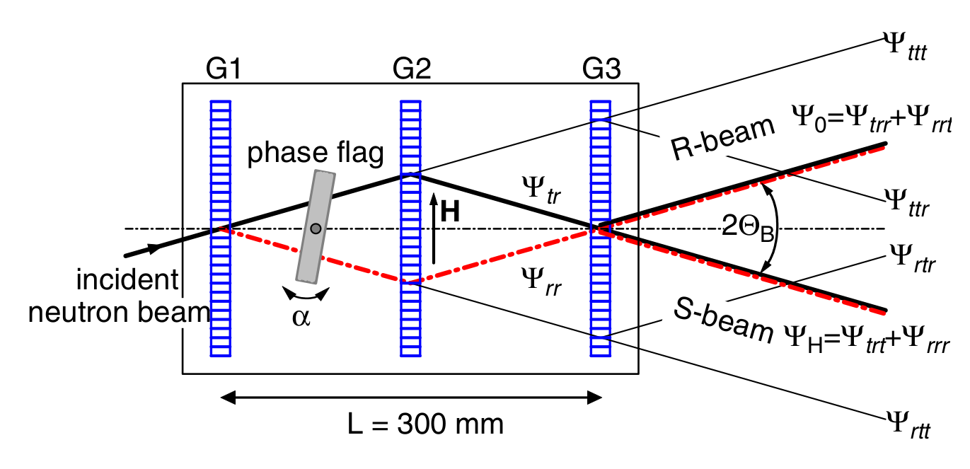
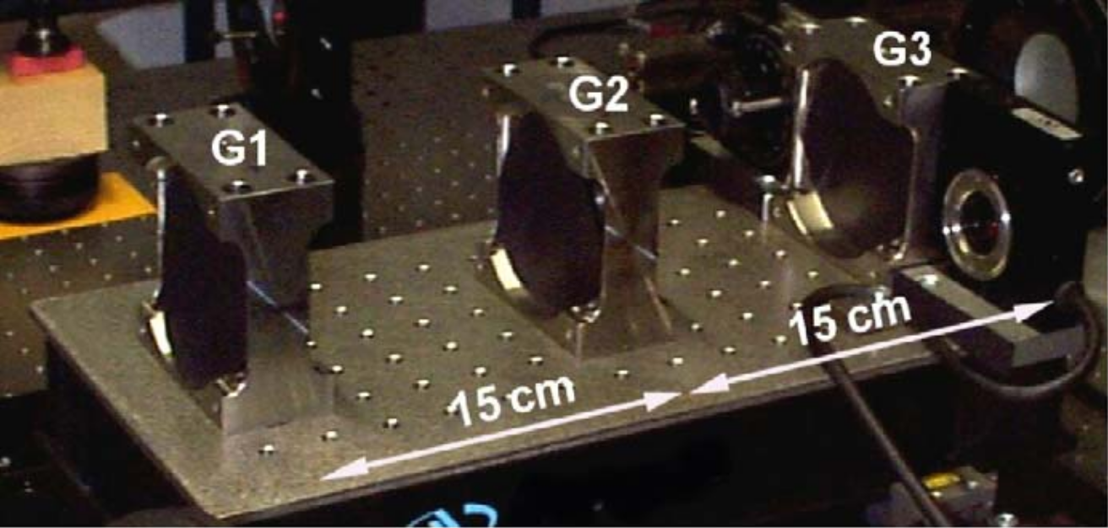
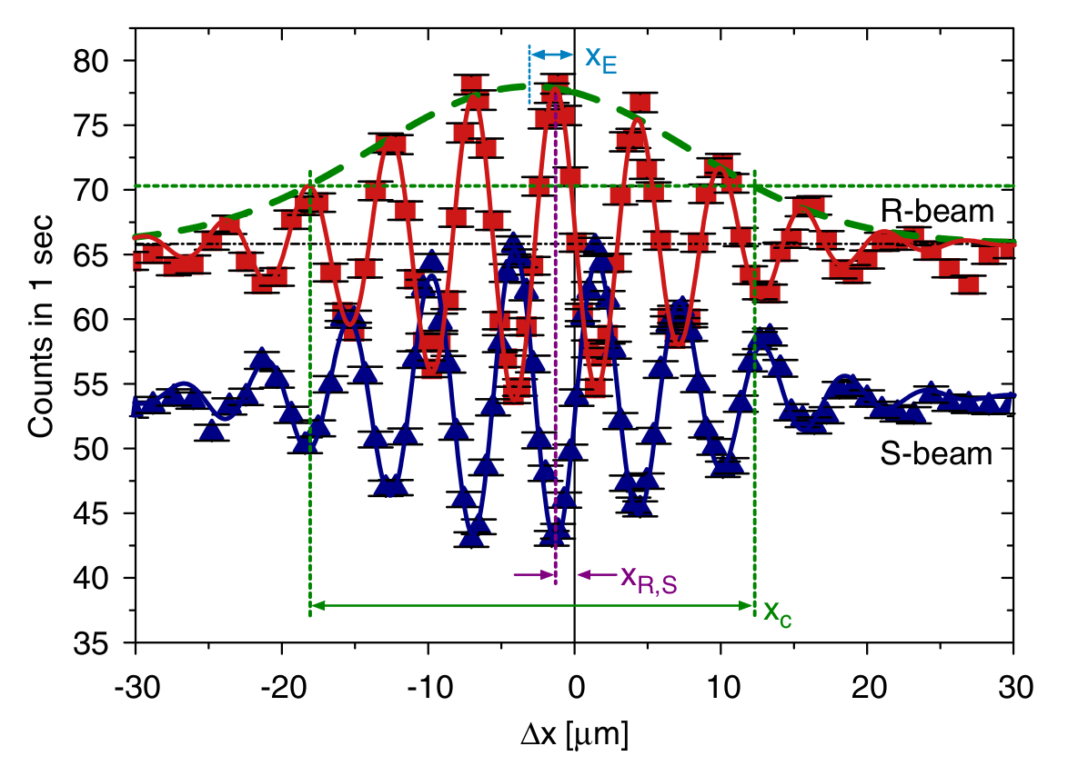
PENDELLÖSUNG INTERFERENCE

Slide 35
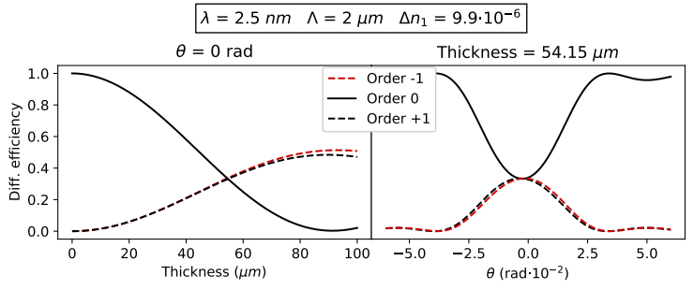
PENDELLÖSUNG INTERFERENCE

Slide 36
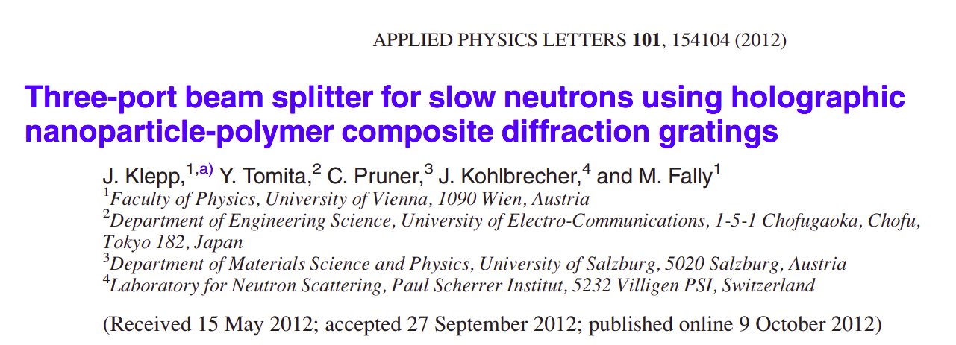
PENDELLÖSUNG INTERFERENCE
Jürgen Klepp et al. “Three-port beam splitter for slow neutrons using holographic nanoparticle-polymer composite diffraction gratings”. In: Applied Physics Letters 101.15 (2012), p. 154104.

Slide 37
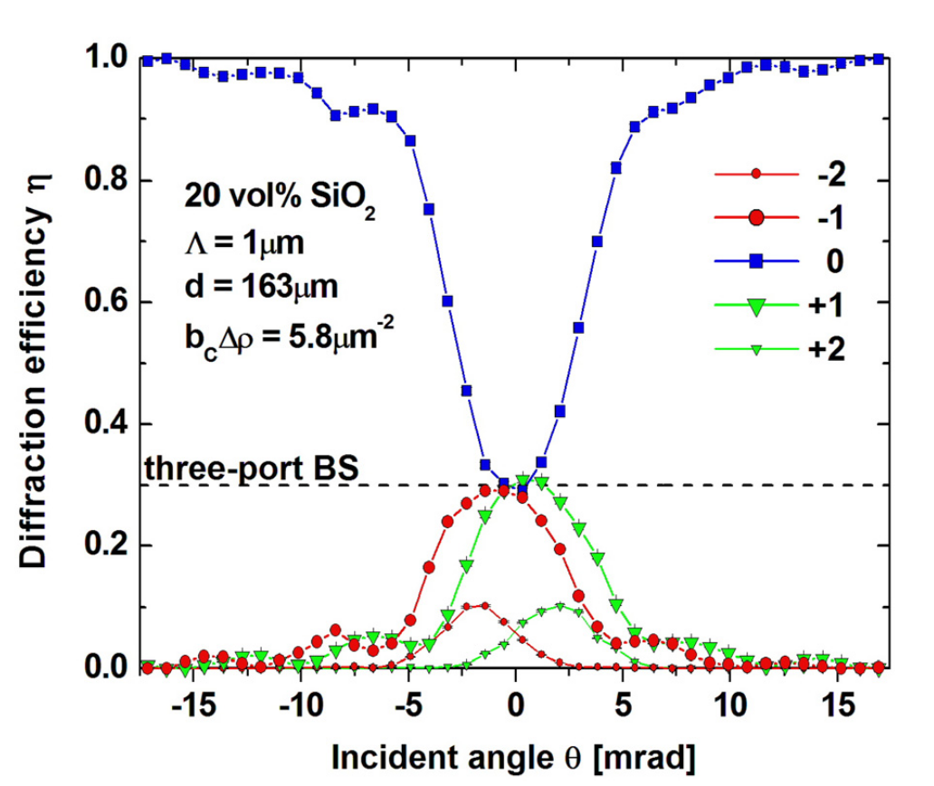
PENDELLÖSUNG INTERFERENCE
Jürgen Klepp et al. “Three-port beam splitter for slow neutrons using holographic nanoparticle-polymer composite diffraction gratings”. In: Applied Physics Letters 101.15 (2012), p. 154104.

Slide 38
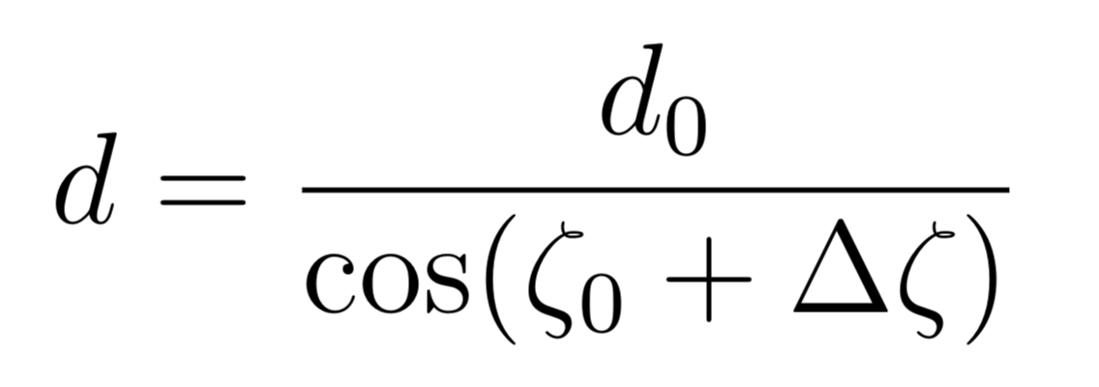
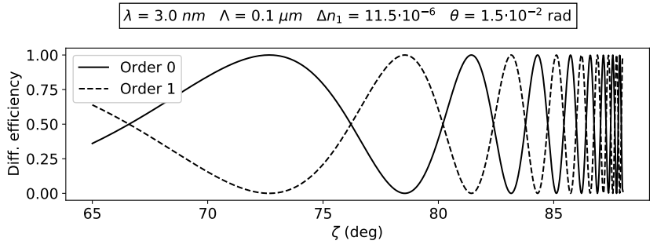
PENDELLÖSUNG INTERFERENCE
θ
THICKNESS MODULATION BY TILT
ζ
Incoming
beam
Diff. grating

Slide 39
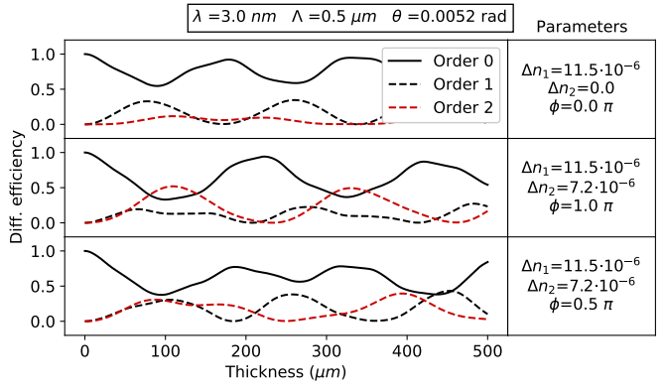
PENDELLÖSUNG INTERFERENCE

Slide 40
THE EXPERIMENT

Slide 41
THE SAMPLE
NANOPARTICLE-POLYMER COMPOSITE (NPC) DIFFRACTION GRATING
d
Thickness (d) | Grating period (Λ)
78 μm | 0.5 μm

Slide 42
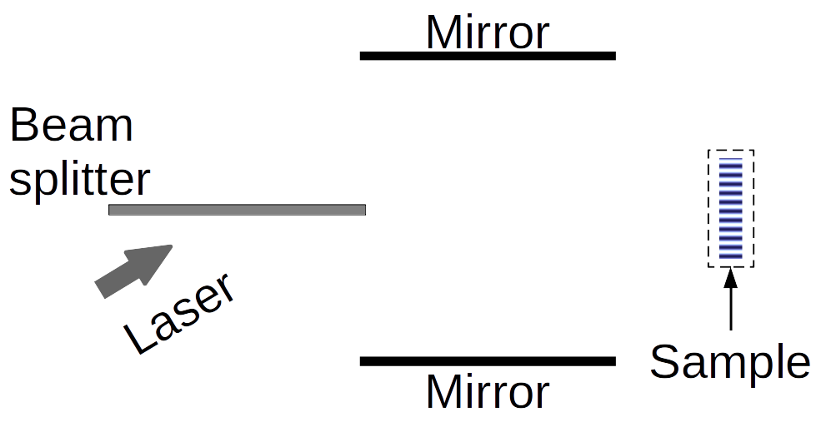
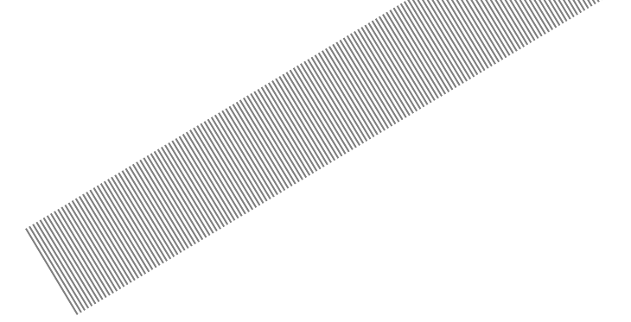




THE SAMPLE
NANOPARTICLE-POLYMER COMPOSITE (NPC) DIFFRACTION GRATING¹
LIGHT INTENSITY PROFILE
¹Yasuo Tomita, Naoaki Suzuki, and Katsumi Chikama. “Holographic manipulation of nanoparticle distribution morphology in nanoparticle-dispersed photopolymers”. In: Optics letters 30.8 (2005), pp. 839–841.

Slide 43

THE SAMPLE
NANOPARTICLE-POLYMER COMPOSITE (NPC) DIFFRACTION GRATING¹
¹Yasuo Tomita, Naoaki Suzuki, and Katsumi Chikama. “Holographic manipulation of nanoparticle distribution morphology in nanoparticle-dispersed photopolymers”. In: Optics letters 30.8 (2005), pp. 839–841.

Slide 44

THE SAMPLE
NANOPARTICLE-POLYMER COMPOSITE (NPC) DIFFRACTION GRATING¹
NEUTRON REFRACTIVE INDEX²
²Varley F. Sears. Neutron Optics: An Introduction to the Theory of Neutron Optical Phenomena and Their Applications. Oxford series on neutron scattering in condensed matter. Oxford University Press, 1989.

Slide 45

THE SAMPLE
NANOPARTICLE-POLYMER COMPOSITE (NPC) DIFFRACTION GRATING¹
NEUTRON REFRACTIVE INDEX²
SCATTERING LENGTH-DENSITY
PARAMETER MODULATION^{3,4}
³Martin Fally, J ̈urgen Klepp, and Yasuo Tomita. “An experimental study on the validity of diffraction theories for off-Bragg replay of volume holographic gratings”. In: Applied Physics B 108 (July 2012).
⁴Jürgen Klepp et al. “Mirrors for slow neutrons from holographic nanoparticle -polymerfree-standing film-gratings”. In: Applied Physics Letters 100 (Mar. 2012), p. 214104.

Slide 46

THE SAMPLE
NANOPARTICLE-POLYMER COMPOSITE (NPC) DIFFRACTION GRATING¹
REFRACTIVE INDEX MODULATION PROFILE
¹Yasuo Tomita, Naoaki Suzuki, and Katsumi Chikama. “Holographic manipulation of nanoparticle distribution morphology in nanoparticle-dispersed photopolymers”. In: Optics letters 30.8 (2005), pp. 839–841.

Slide 47
THE MEASUREMENTS
θ
Incoming
beam
θ
-2
1
-1
0

Slide 48
THE MEASUREMENTS
θ
θ
ζ
ζ
Incoming
beam
Diff. grating
Diff. grating

Slide 49

THE MEASUREMENTS

Slide 50

THE MEASUREMENTS

Slide 51

THE MEASUREMENTS

Slide 52
EXPERIMENTAL SET-UP
190 cm
15 cm
146 cm
18 cm
Helium pipe
Helium pipe
Mirror
175 cm
130 cm
Neutron
beam
Sample
Cadmium frame with
~1x1 cm²
aperture
1x1 mm²
apertures

Slide 53





THE INSTRUMENT
INSTUTE LAUE-LANGEVIN - PF2
VERY COLD NEUTRONS
EXPONENTIALLY MODIFIED GAUSSIAN
Matthias Blaickner et al. “Monte-Carlo simulation of neutron transmission through nanocomposite materials for neutron-optics applications”. In: Nuclear Instruments and Methods in Physics Research Section A: Accelerators, Spectrometers, Detectors and Associated Equipment 916 (2019), pp. 154–157. issn: 0168-9002.

Slide 54


THE INSTRUMENT
Kurt Eder et al. “The new very-cold-neutron optics facility at ILL”. In: Nuclear Instruments and Methods in Physics Research Section A: Accelerators, Spectrometers, Detectors and Associated Equipment 284.1 (1989), pp. 171–175. issn: 0168-9002.

Slide 55
DATA ANALYSIS
PRELIMINARY ANALYSIS

Slide 56

PRELIMINARY ANALYSIS
Johannes Schindelin et al. “Fiji: an open-source platform for biological image analysis”. In: Nature methods 9.7 (2012), pp. 676–682

Slide 57




DIVERGENCE
DIVERGENCE HALF-ANGLE
Expected:
Measured:

Slide 58

SPOTS SHAPE
ζ=0º
ζ=69º
ζ=80º

Slide 59


SPOTS SHAPE

Slide 60

SPOTS POSITION

Slide 61

NEUTRON INTENSITY

Slide 62

HELIUM PIPES SHADOW

Slide 63
DATA ANALYSIS
DIFFRACTION EFFICIENCIES

Slide 64

REGION OF INTEREST

Slide 65



ROWS OF INTEREST
z
STEP 1: Import the measurements as 2D arrays and stack them in a 3D array
x
y
x
x
x
y
y
y
z

Slide 66

ROWS OF INTEREST
STEP 1: Import the measurements as 2D arrays and stack them in a 3D array
STEP 2: Create a projection on the (x, y) pixel plane of the maximum values along the z axis

Slide 67

ROWS OF INTEREST
STEP 1: Import the measurements as 2D arrays and stack them in a 3D array
STEP 2: Create a projection on the (x, y) pixel plane of the maximum values along the z axis
STEP 3: Find the coordinates (x,y,z) of the pixel with the absolute maximum counts
P_{max} = [x_{max}, y_{max}]

Slide 68


ROWS OF INTEREST
STEP 1: Import the measurements as 2D arrays and stack them in a 3D array
STEP 2: Create a projection on the (x, y) pixel plane of the maximum values along the z axis
STEP 3: Find the coordinates (x,y,z) of the pixel with the absolute maximum counts
STEP 4: Define an approximate range for the limiting rows of the ROI and use the signal-to-noise ratio (S/N) to find the first row
(3 consecutive pixels with S/N>3)

Slide 69

COLUMNS OF INTEREST
Same procedure row by row.
(2 consecutive pixels with S/N>1.5 and S/N>2)

Slide 70
ANGLE OF INCIDENCE
z
x
y
x
x
x
y
y
y
z

Slide 71




ANGLE OF INCIDENCE
z
x
y

Slide 72

ANGLE OF INCIDENCE

Slide 73




NEUTRON COUNTS
MEASURED DIFFRACTION EFFICIENCIES
-1
0
+1
+2
-1
0
+1
+2

Slide 74




NEUTRON COUNTS
MEASURED DIFFRACTION EFFICIENCIES
FIT PROFILE
COUNTS DISTRIBUTION

Slide 75

NEUTRON COUNTS

Slide 76

UNCERTAINTIES

Slide 77


UNCERTAINTIES
UNCERTAINTY ON NEUTRON COUNTS
UNCERTAINTY ON DIFFRACTION EFFICIENCY

Slide 78

DIFFRACTION EFFICIENCY

Slide 79

PENDELLÖSUNG EFFECT

Slide 80
DATA ANALYSIS
WAVELENGTH DISTRIBUTION AND BEAM DIVERGENCE

Slide 81


WAVELENGTH DISTRIBUTION
MONOCHROMATIC AND PERFECTLY PARALLEL
WAVELENGTH DISTRIBUTION CONTRIBUTION

Slide 82


WAVELENGTH DISTRIBUTION
INVERSE TRANSFORM SAMPLING
WEIGHTED SAMPLING

Slide 83

WAVELENGTH DISTRIBUTION
EXPONENTIALLY MODIFIED GAUSSIAN
INITIAL PARAMETERS

Slide 84



BEAM DIVERGENCE
BEAM DIVERGENCE CONTRIBUTION
BEAM PROFILE

Slide 85
DATA ANALYSIS
FITS RESULTS

Slide 86

FIT RESULTS
MODEL
9 coupled waves (0, ±1, ±2, ±3, ±4)
n₀ = 1
EMG wavelength distribution
Gaussian beam profile

Slide 87


PERFECTLY SINUSOIDAL GRATING
GRATING PROFILE
EMG PARAMETERS
FREE PARAMETERS

Slide 88

PERFECTLY SINUSOIDAL GRATING

Slide 89

PERFECTLY SINUSOIDAL GRATING

Slide 90

PERFECTLY SINUSOIDAL GRATING
GRATING PROFILE
EMG PARAMETERS
FREE PARAMETERS

Slide 91

PERFECTLY SINUSOIDAL GRATING

Slide 92

PERFECTLY SINUSOIDAL GRATING
GRATING PROFILE
FREE PARAMETERS

Slide 93

PERFECTLY SINUSOIDAL GRATING

Slide 94

PERFECTLY SINUSOIDAL GRATING

Slide 95

PERFECTLY SINUSOIDAL GRATING
WAVELENGTH DISTRIBUTION

Slide 96

PERFECTLY SINUSOIDAL GRATING
WAVELENGTH DISTRIBUTION

Slide 97

PERFECTLY SINUSOIDAL GRATING
WAVELENGTH DISTRIBUTION

Slide 98

PERFECTLY SINUSOIDAL GRATING
SCATTERING LENGTH-DENSITY PARAMETER

Slide 99

PERFECTLY SINUSOIDAL GRATING
PENDELLÖSUNG INTERFERENCE

Slide 100

PERFECTLY SINUSOIDAL GRATING

Slide 101

PERFECTLY SINUSOIDAL GRATING

Slide 102
TWO FOURIER COMPONENTS
GRATING PROFILE
FREE PARAMETERS

Slide 103


TWO FOURIER COMPONENTS

Slide 104
TWO FOURIER COMPONENTS

Slide 105


TWO FOURIER COMPONENTS

Slide 106
TWO FOURIER COMPONENTS

Slide 107

PERFECTLY SINUSOIDAL GRATING
PENDELLÖSUNG INTERFERENCE

Slide 108
SUMMARY AND CONCLUTIONS
FITS RESULTS

Slide 109

SUMMARY
EXPERIMENTAL ASPECTS
CAUSES
Temporary changes in the neutron source
Temporary changes in the neutron flux
intentional interruption by people operating in the same facility;

Slide 110
SUMMARY
EXPERIMENTAL ASPECTS
SOLUTION
Plotting the total neutron counts at the end of each measurement (or measurement session) can disclose any relevant variation in the neutron flux, which might be an indication of a compromised measurement that needs to
be discarded or re-taken.

Slide 111
SUMMARY
EXPERIMENTAL ASPECTS
CAUSES
Changes in the experimental setting
Mistakes during set-up adjustments

Slide 112
SUMMARY
EXPERIMENTAL ASPECTS
SOLUTION
Converting the
measurements to images and running a quick scan of the position of the spots
reveal unwanted changes in the experimental set-up.

Slide 113
SUMMARY
EXPERIMENTAL ASPECTS
CAUSES
Broad wavelength distribution
Ratio Λ/λ

Slide 114
SUMMARY
EXPERIMENTAL ASPECTS
SOLUTION
Using a neutron source with a thinner WL distribution, or adjusting the ratio Λ/λ

Slide 115
SUMMARY
EXPERIMENTAL ASPECTS
CAUSES
He pipes used to reduce neutron-air scattering

Slide 116
SUMMARY
EXPERIMENTAL ASPECTS
SOLUTIONS
Increasing pipes dimension

